Slide 1
Using DES, Elliptic DH and El-Gamal Signature
Sending Email Securely
Aviv Eitam, Anton Grudsky, Ori Burshtein

Slide 2
How does it work
Alice
Bob
Alice initiate communication with Bob
Waiting for client connection
Connection established
ECDH key generation
ECDH key generation
El-Gamal key signing (Bob's ECDH public key)
El-Gamal key signing (Alice's ECDH public key)
Alice send her public key with signature to Bob
Bob send his public key with signature to Alice
ECDH signed key exchange
Verify Bob's key signature
Verify Alice's key signature
Calculate the product of Alice's private and Bob's public key
DES email encryption with the shared secret key
Calculate the product of Bob's private and Alice's public key
Create Specific Signature for the message
Sending email with signature
Verify message signature
Email DES decryption with the shared secret key

Slide 3
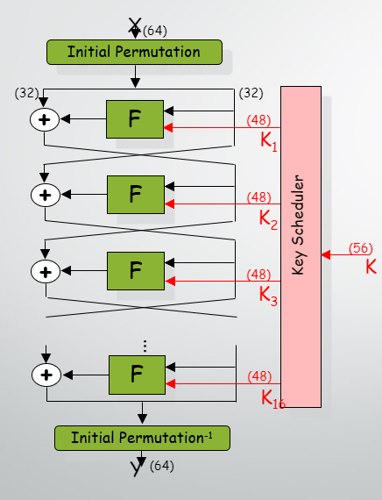
DES - STRUCTURE
Input size: 64 bit
Output size: 64 bit
Key size: 56 bit
16 Rounds

Slide 4
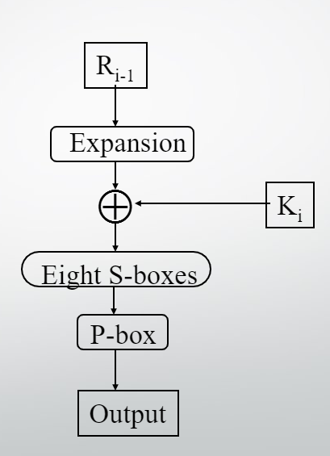
DES – Function F
Expand right side from 32 to 48 bits (some get reused)
Add 48 bits of key (chosen by schedule)
S-boxes: each set of 6 bits reduced to 4
P-box permutes 32 bits

Slide 5
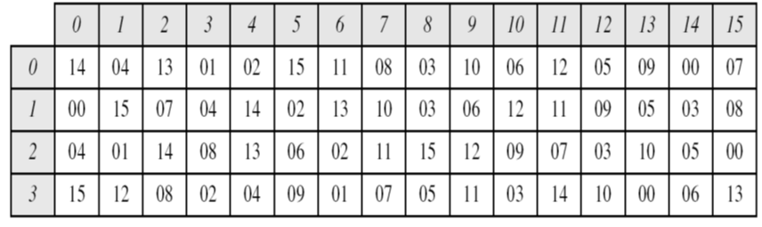
DES - S-BOX
Column = 13
Input: 011011
Output: 0101
Row = 1

Slide 6
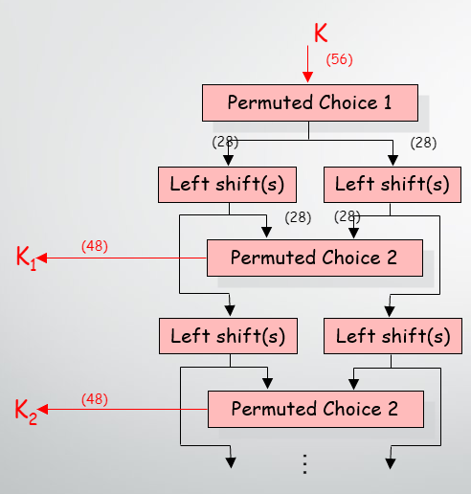
The DES key scheduler

Slide 7
DES Decrypting
To decrypt we only need to apply the very same algorithm with the same keys in reverse order to an encrypted message block.

Slide 8
Encrypting Long Texts
Break plaintext into 64bit blocks and apply cipher on each block.
ECB – Electronic Codebook used to encipher a single plaintext block (e.g., a DES key).
CBC – Cipher Block Chaining repeated use of the encryption algorithm to encipher a message consisting of many blocks.

Slide 9
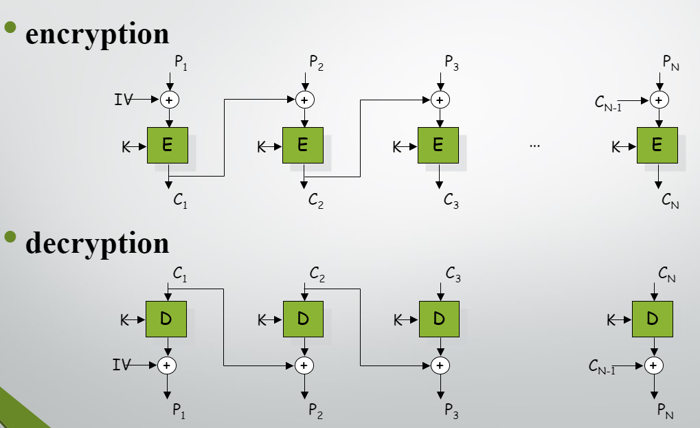
CBC MODE

Slide 10
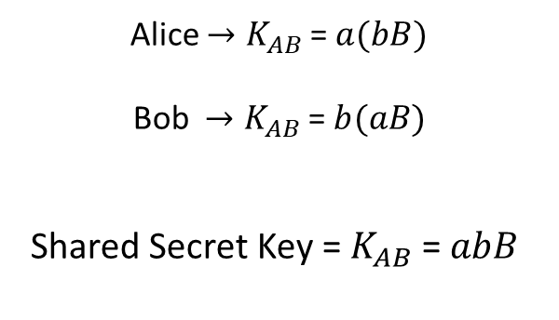
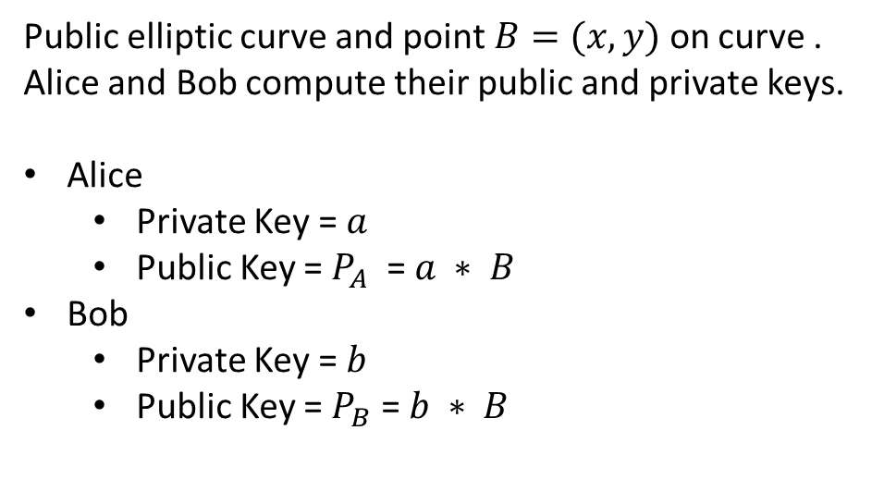
Elliptic Curve Diffie Hellman
Public elliptic curve and point $B=(x,y)$ on curve .
Alice and Bob compute their public and private keys.
Alice
Private Key = $a$
Public Key = $P_{A}$ = $a ∗ B$
Bob
Private Key = $b$
Public Key = $P_{B}$ = $b ∗ B$
Alice ${→K}_{AB}$ = $a(bB)$
Bob ${→K}_{AB}$ = $b(aB)$
Shared Secret Key = $K_{AB}$ = $abB$

Slide 11
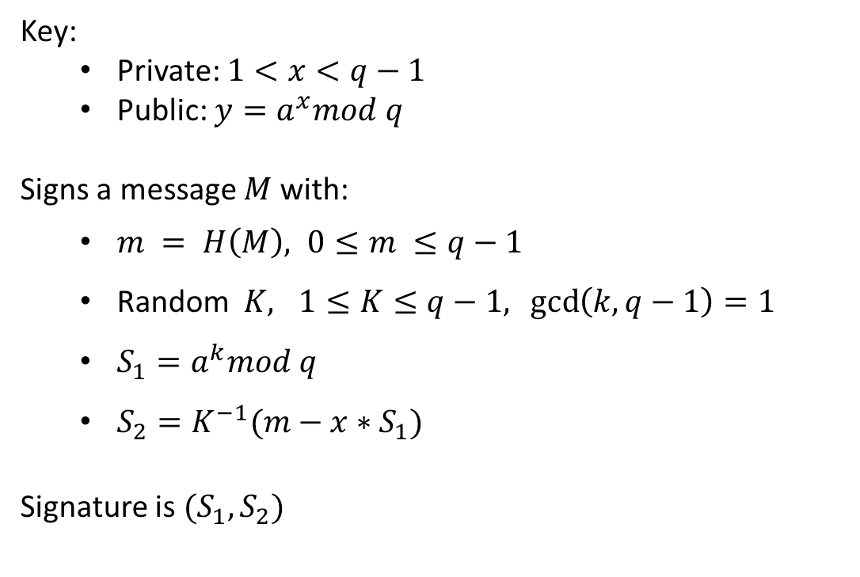
El-Gamal Digital Signature
Key:
Private: $1<x<q−1$
Public: $y=a^{x}mod q$
Signs a message $M$ with:
$m = H\left(M\right), 0≤m ≤q−1$
Random $K, 1≤K≤q−1, \gcd\left(k,q−1\right)=1$
$S_{1}=a^{k}mod q$
$S_{2}=K^{−1}(m−x∗S_{1})$
Signature is $(S_{1}, S_{2})$

Slide 12
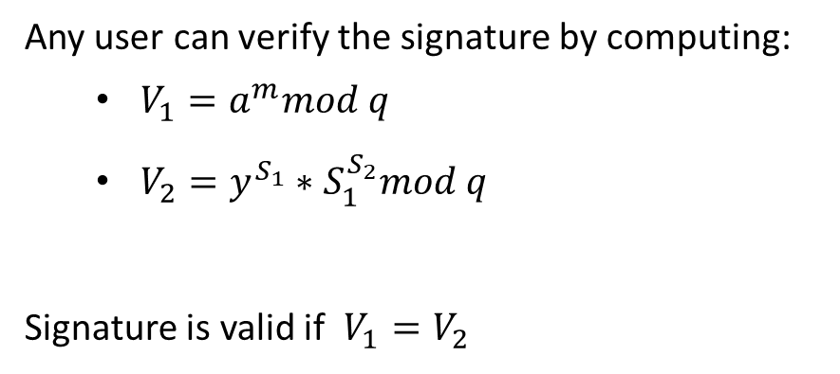
El-Gamal Digital Signature - Verification
Any user can verify the signature by computing:
$V_{1}=a^{m}mod q$
$V_{2}=y^{S_{1}}∗S_{1}^{S_{2}}mod q$
Signature is valid if $V_{1}=V_{2}$

Slide 13
Thank You!

